Slide 1
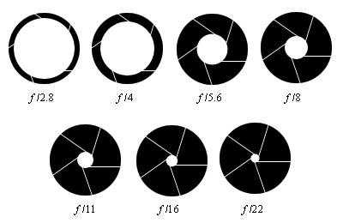
Aperture
Manipulating Depth of Field

Slide 2
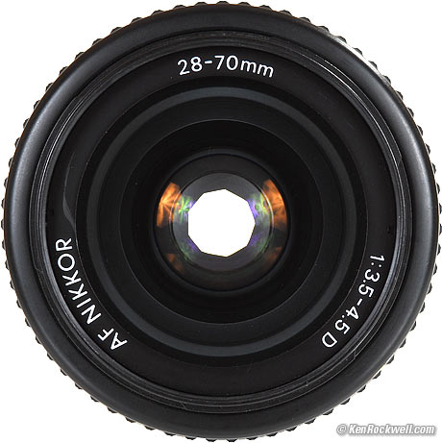
What/ where is it?
Put most simply – Aperture is ‘the size of the opening in the lens when a picture is taken.’
When you hit the shutter release button of your camera a hole opens up that allows your cameras image sensor to catch a glimpse of the scene you’re wanting to capture. The aperture that you set impacts the size of that hole. The larger the hole the more light that gets in – the smaller the hole the less light.

Slide 3
Aperture is measured in ‘f-stops’. You’ll often see them referred to f/number – for example f/2.8, f/4, f/5.6,f/8,f/22 etc. Moving from one f-stop to the next doubles or halves the size of the amount of opening in your lens (and the amount of light getting through).
One thing that causes a lot of new photographers confusion is that large apertures (where lots of light gets through) are given f/stop smaller numbers and smaller apertures (where less light gets through) have larger f-stop numbers. So f/2.8 is in fact a much larger aperture than f/22. It seems the wrong way around when you first hear it but you’ll get the hang of it.

Slide 4
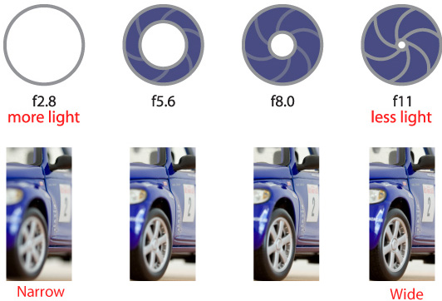
F-Stops

Slide 5
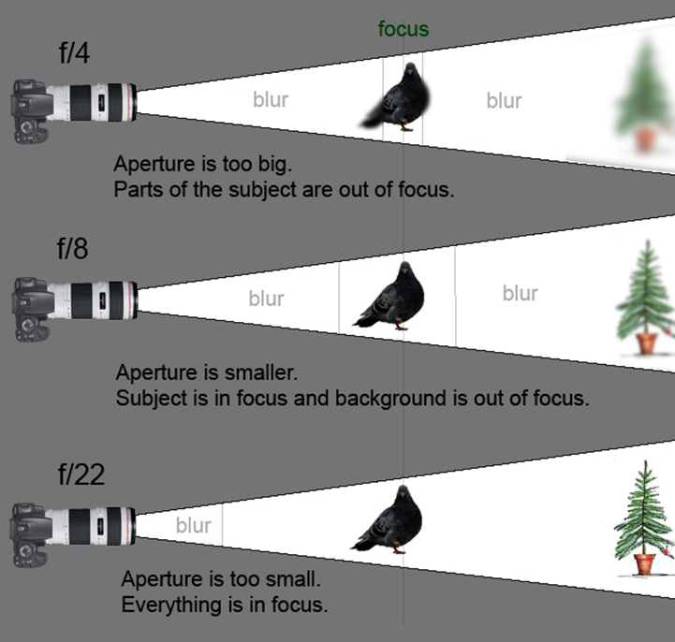

Slide 6
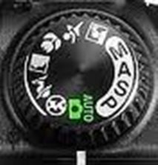
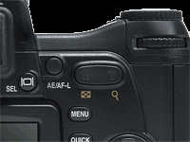
How to set your camera…
On your camera you need to turn the dial to the “A” setting.
You move the F-stops by moving the “dial”

Slide 7
F-3.8

Slide 8
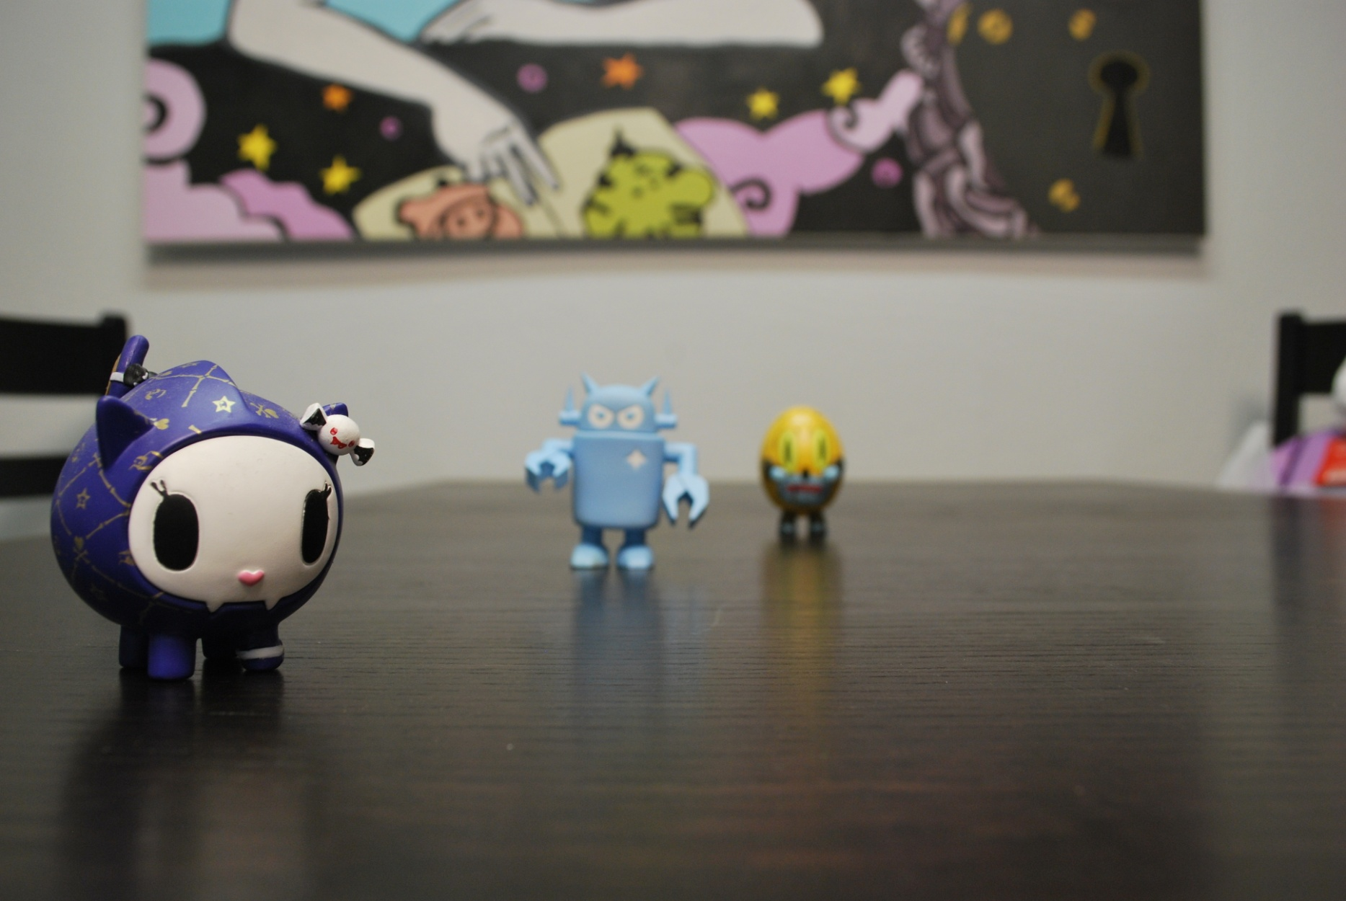
F-8

Slide 9
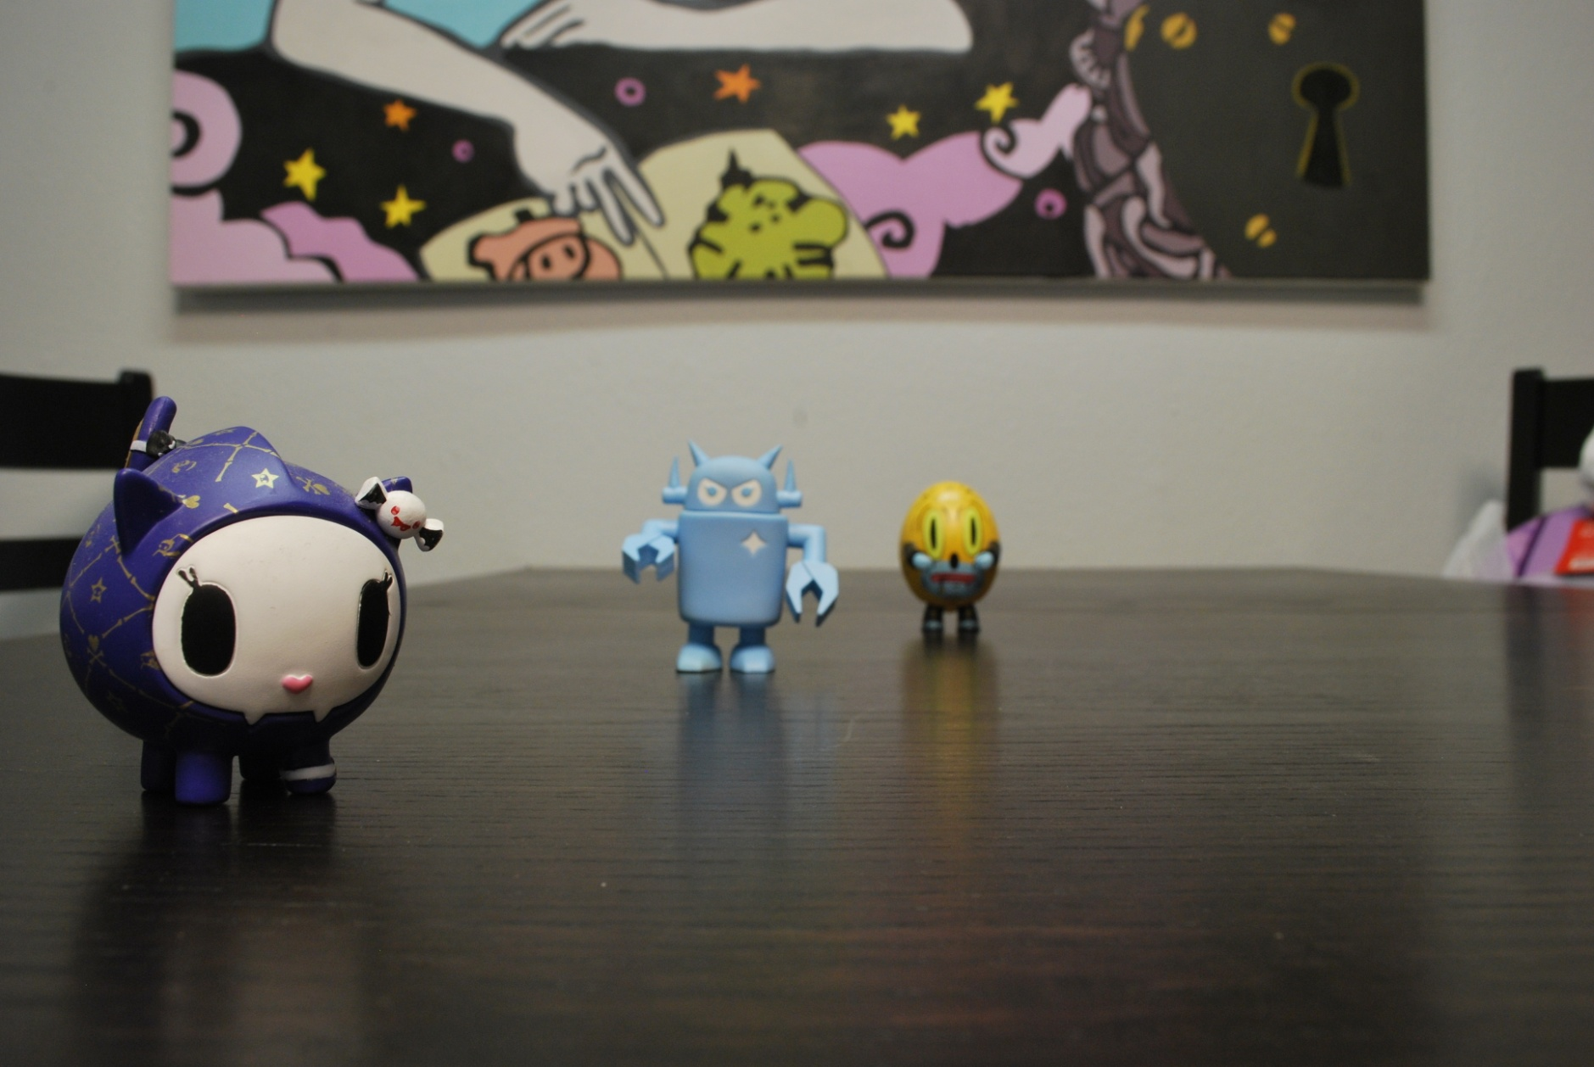
F-13

Slide 10
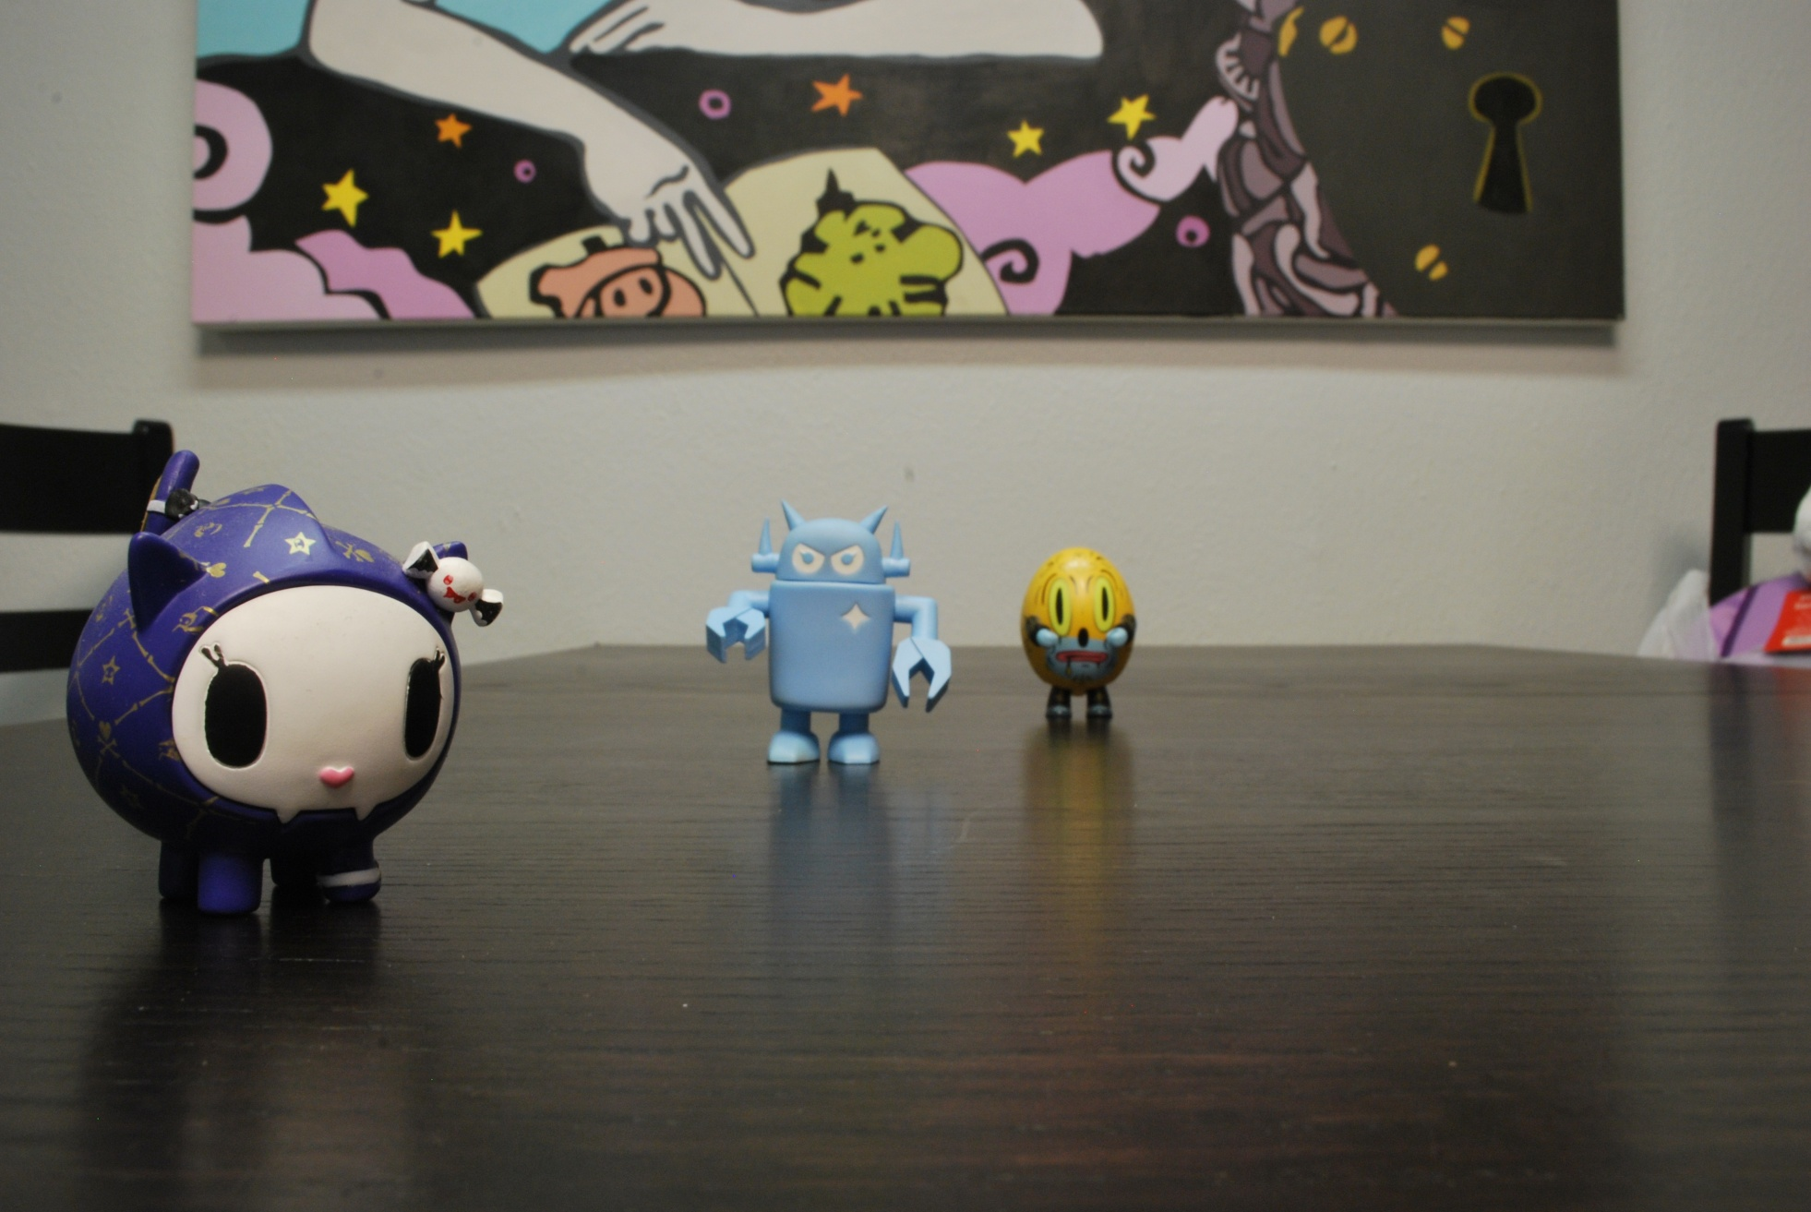
F-20

Slide 11
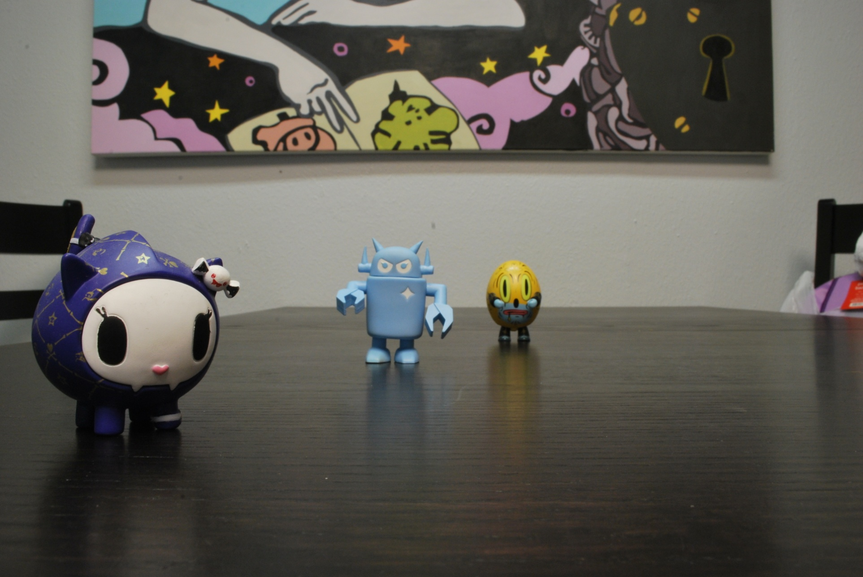
F-25

Slide 12
Practice Time.
Pick 3 toys and find a flat stable surface.
Take 5 pictures.
Start at the lowest f-stop and end at the highest. Keep the camera in the same place and make sure the area around you is kept clear and still.
Toy 3
8-18 inches
Toy 2
8-18 inches
Toy 1
Camera
The better the quality of light the higher the F-stop you can achieve.

Slide 13
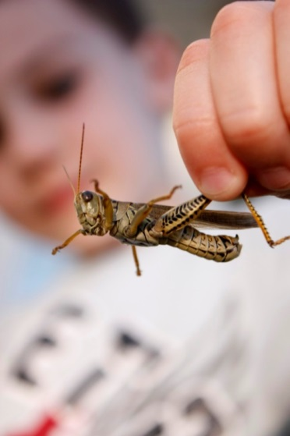
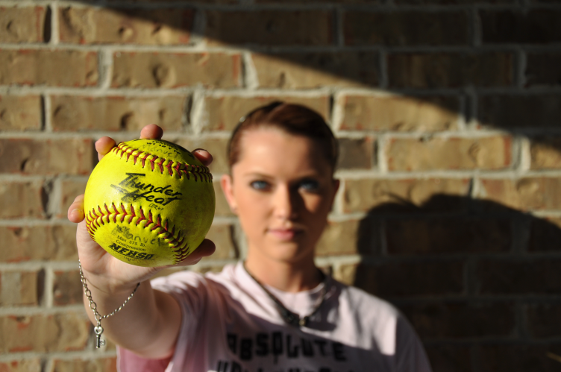
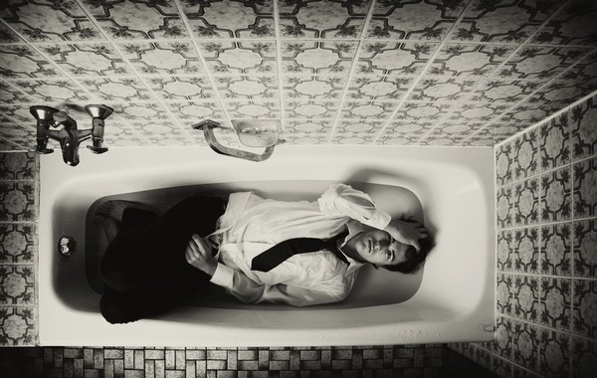
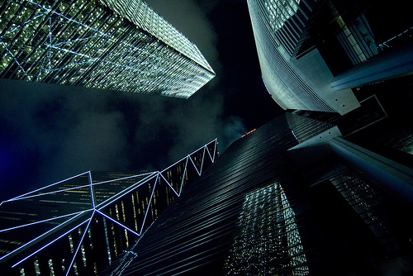
\
Aperture Assignment #2
Due at the end of class monday in your file.
(under assignments in folder named “Aperature2”, rename one “high” and one “low”)
You need to take two pictures- these should be creative and investigative. By the end of this week I want you to know what you can use the Aperture setting for, these photos should prove that you “got this”.
Take a photo (your choice) illustrating how a low f-stop can affect your photo. Low F-stop = more light which equals less area in focus. Examples:
Take a photo (your choice) using a HIGH f-stop (less light, more info), making sure that you have a large area of focus. Try taking this one from
an interesting point of view. Examples:

